Slide 1
Development Contributions Review
Have Your Say
September 2021

Slide 2
Key consultation topics
Recovery Budget investment programme
Recovering costs beyond 2031
Payment timing
Supporting development of Māori land
Updates to capex and growth share
Weighted average urban price
$21,500
First area is Drury
DCs due at building consent 6 to 24 months earlier than at present
Through grants

Slide 3
Capex update for 10-year budget
  $32 billion investment incl $9 billion with growth element and
updates since 2018
Development contributions recover the cost of the growth share
Infrastructure funded by rates, Waka Kotahi transport subsidies and development contributions

Slide 4
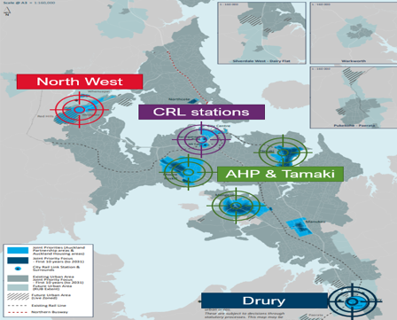
Programmes outside 10 years
Proposal
Stage addition of growth infrastructure beyond 10 years to investment priority areas over the next year
Beginning with Drury – transport, reserves and community infrastructure
Reason for change
Cumulative impact of growth requires major investment
  Beyond capacity of 10-year budget despite commitment to investment priority areas
Reduces future service level shortfalls and funding challenges
Fair that early developers pay their share

Slide 5
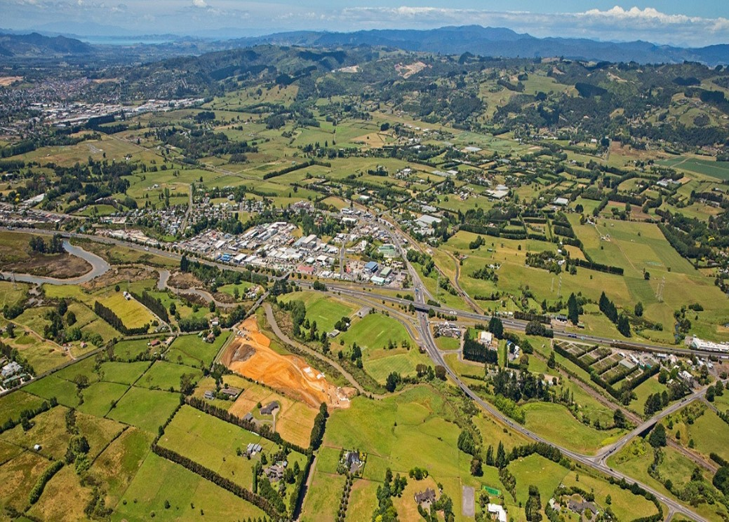
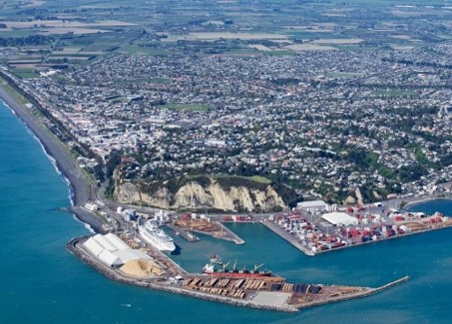
Development in Drury
Significant development over the next 30 years
22,000 houses expected
Similar size to Napier

Slide 6
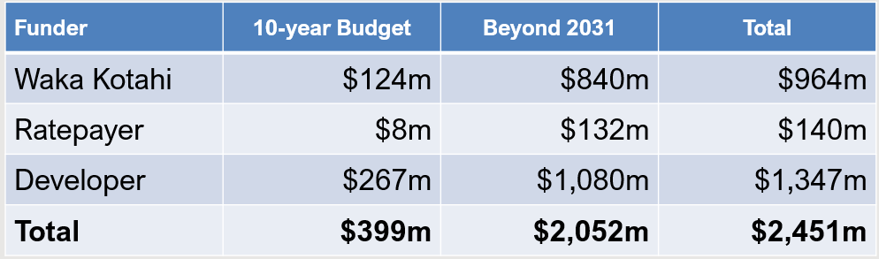
Planned investment in Drury
    Includes local transport, parks and community infrastructure
  on top of significant Crown investment
  timing of council investment constrained
$2.5b
Funding area | DC price per HUE including local, sub-regional and regional charges
 | 2019 policy | 2021 capex updates | Add projects outside 10 years
Drury - Opaheke | $11,000 - $18.300 | $34,300 | $84,900
Southern Drury | $19,300 - $41,200 | $14,200 - $39,300 | $14,600 to $37,900

Slide 7
Payment timing – building consents
Propose all DCs due at grant of building consent
  Council finances under stress from COVID-19
  Earlier payment allows earlier investment in infrastructure
  No impact on revenue just paid earlier - $96m extra over next 3 financial years (to June 2024) - $107m with projects beyond 2031 in Drury
  Less interest cost recovery means DC price down to $19,300 not including beyond 2031 projects
  Residential and non-residential payable on grant of consent
2019 policy extended payment timing for DCs due at building consent for residential
  6 months for less than 5 attached dwellings and CCC or 24 months for greater than 5 attached dwellings
  Payment closer to realisation of cash from development

Slide 8
New legislative obligation
Support via grants
  (marae and papakāinga and Māori housing on Māori land)
  alternative is remissions
exempt not-for-profit development on Māori land from reserve contributions
retain the current payment timing for contributions for non-commercial development on Māori land
Supporting development of Māori land

Slide 9
Patai?

