Slide 1


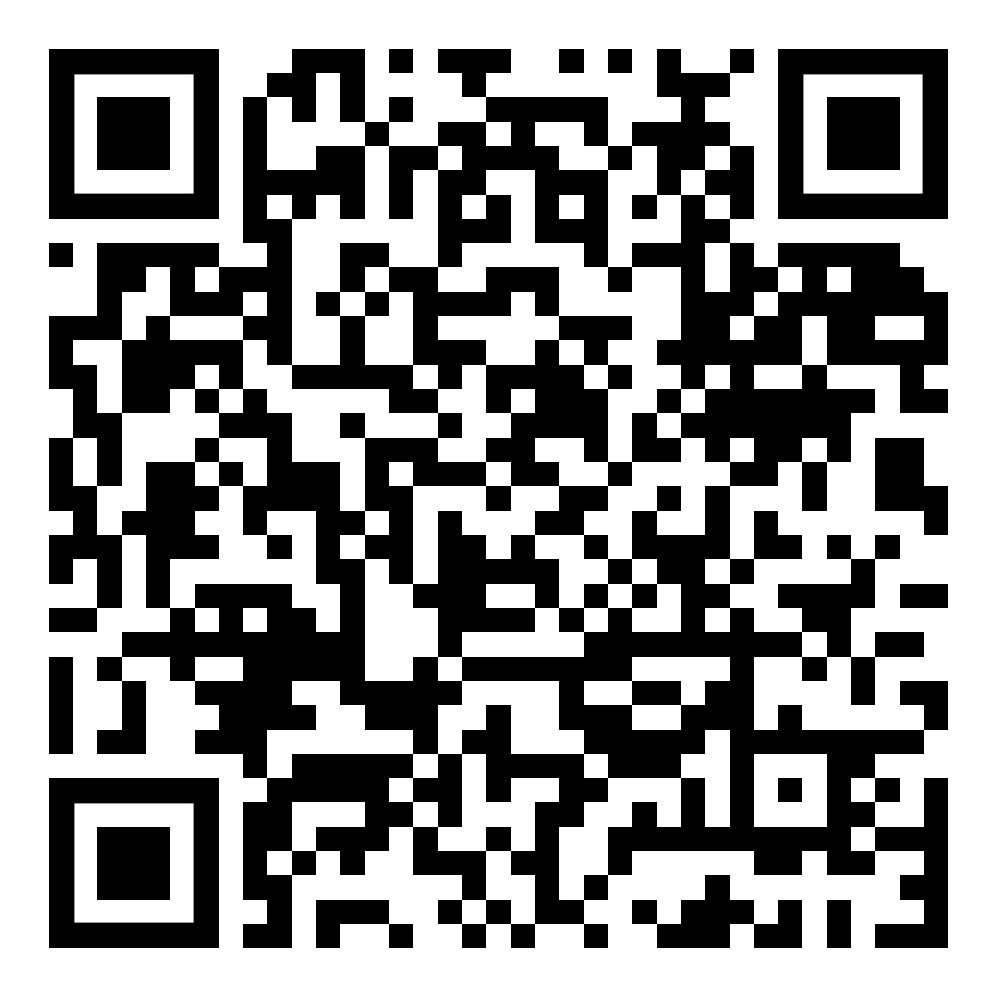
      Papakura Local Board
  Local Parks Management Plan
    Planning the future of your local parks
    Have your say by 11 November 2023
    For more information visit akhaveyoursay.nz or your local library. Scan the QR code to give your feedback.

