Slide 1
Franklin Local Parks Management Plan
Summary of submissions from the first round of public consultation
March 2024

Slide 2
Summary of presentation
The Franklin Local Board area currently has approximately 295 Council owned local parks and reserves.
The local board is preparing a management plan to inform current and future use, enjoyment, protection of its local park network.
To inform development of the management plan, in the first round of consultation, the public was asked to comment on what they’d like to see in the management plan.
The public were asked for feedback between October – November 2023. 190 submissions were received.
This presentation provides a summary of submission points. The presentation covers the range of reasons people visit their parks, what people enjoy about their parks and what issues people face in their parks currently.

Slide 3
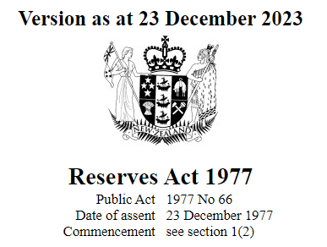
Overview of Franklin Local Park Management Plan project
Required under the Reserves Act 1977
To guide use, management and protection of the land
A handshake with the community
Understand mana whenua’s and community’s values and expectations
Focus is on identifying opportunities, and managing what can and can’t happen on parks
Once completed, the LPMP will replace all existing reserve management plans in a local board area
The project is an opportunity to create an omnibus plan for approximately 295 local parks and reserves in the Franklin Local Board area.

Slide 4
Overview of public consultation
The first steps in the development of the Franklin Local Parks Management Plan (LPMP):
  26 June 2023 – Local board approved public notification of the intention to prepare the LPMP
  12 October to 12 November 2023 – public were notified and invited to make a submission
The submissions received in the recent public engagement period, generally focussed on the following areas:
  The range of reasons people visit their parks
  What people enjoy about their parks
  What issues people face in their parks currently

Slide 5
How the public consultation was publicised?
APPROACHES
Submission period open for 1 month between 12 October and 12 November 2023
Emails to key stakeholders, community and resident organisations, volunteer and environmental groups, local schools
Multiple online engagement channels (AK Have Your Say and Social Pinpoint websites)
20 local park signs
Posters and feedback forms at local libraries
Public notices in local newspapers and OurAuckland article, publicised through Franklin Local Board Facebook page
Wairoa subdivision Community Clinic meeting at Clevedon District Centre (October 2023)
PUBLIC FEEDBACK
303 comments received
from 190 submitters
109 local parks referred to by submitters
15 organisations provided feedback
175 individuals provided feedback

Slide 6
Who gave feedback and how?
175 individuals made submissions:
  57 comments received through AK Have Your Say
  195 comments received through Social Pinpoint
  51 comments received by email and post
15 organisations made submissions that include:
  Environmental groups (Āwhitu Peninsula Landcare, Whakaupoko Landcare, Waiuku Waterfront and Reserves Management Committee, Friends of the Adah Platts Reserve)
  Community organisations (Karaka Sports Park Trust, Pukekohe Scout and Guide Hall, Marama Hou Ministries Trust, Pukekohe Tramping Club, Clevedon Community and Business Association, Counties Baseball Club Inc., Waiuku Museum Society Inc.)
  Local schools (Mauku School, Waiuku College)
  Other organisations (Transpower, Herenga ā Nuku/Outdoor Access Commission)

Slide 7
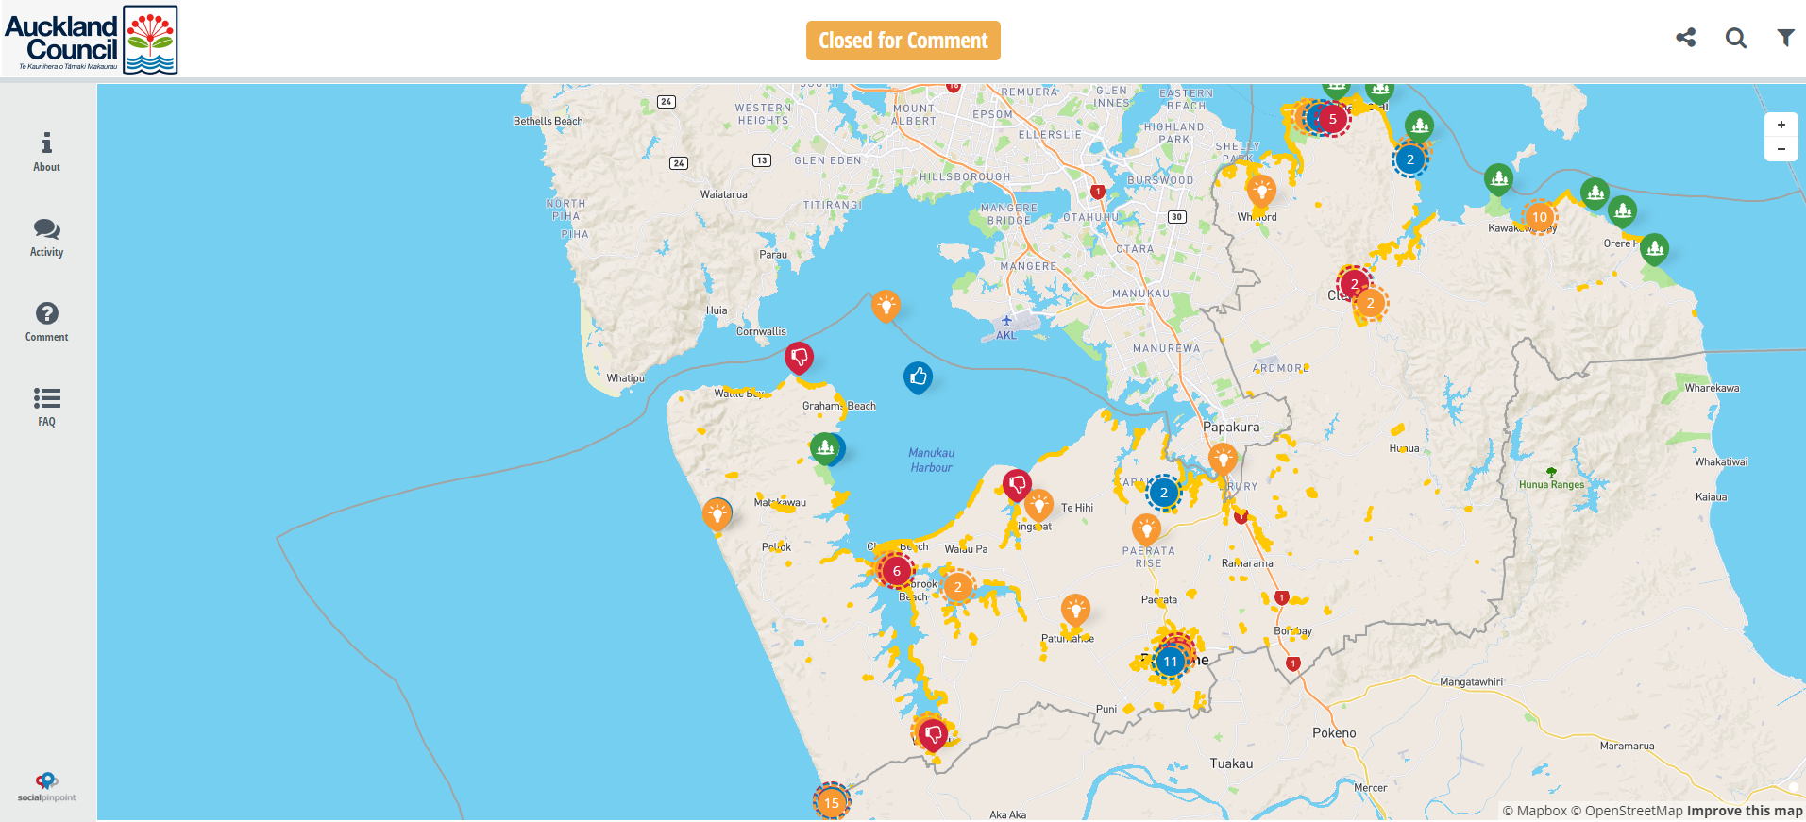
Social Pinpoint – online engagement tool

Slide 8
Demographic information of submitters
By gender
By age
By ethnicity
By local board area
62% - via Auckland Council websites (e.g. AK Have Your Say, Our Auckland)
11% - via Search engine (e.g. Google)
23% - via Email
3% - via Social media (e.g. Facebook)
Disclaimer – these stats include only AK Have Your Say submission data

Slide 9
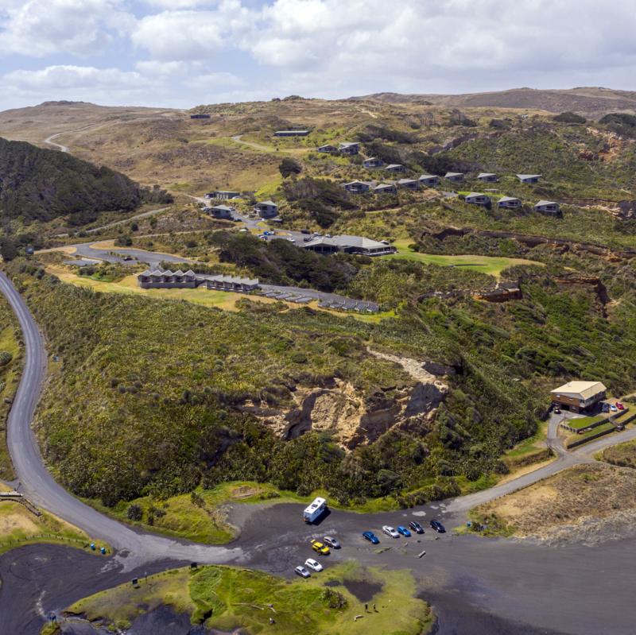
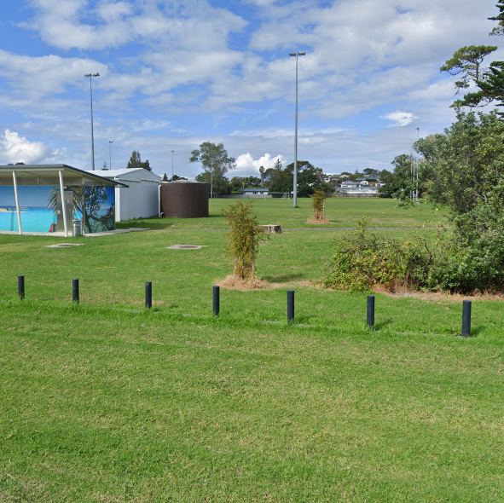
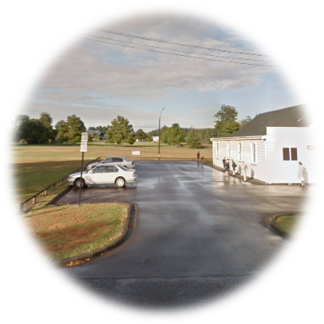
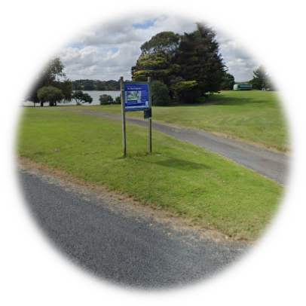
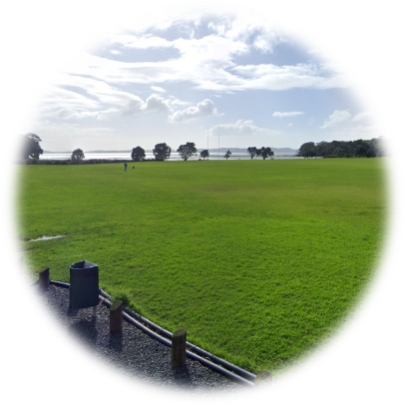
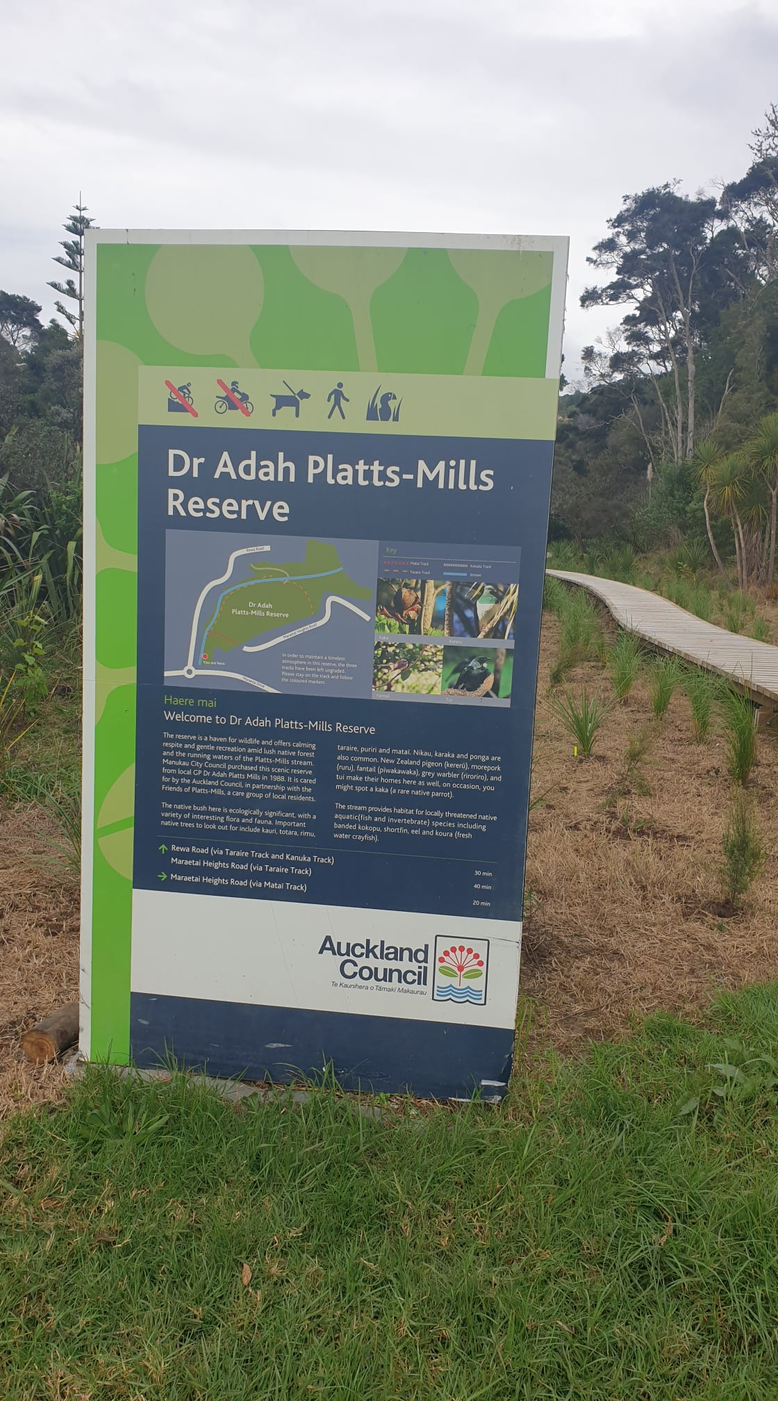
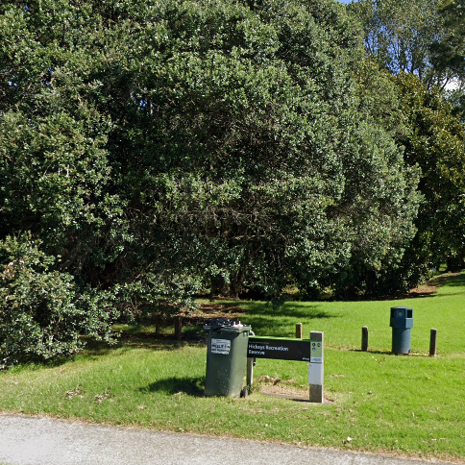
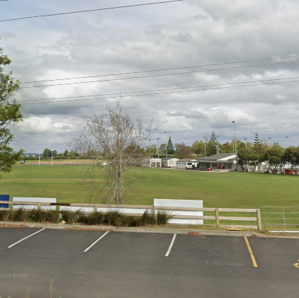
Local parks with the most submitter comments across Franklin
Karioitahi Reserve (41)
Beachlands Domain (27)
Bell Field/Ardmore Hall (19)
Te Toro Recreation Reserve (15)
Te Puru Park (12)
Dr Adah Platts-Mills Reserve (11)
Hickeys Recreation Reserve (9)
Karaka Sports Park (9)

Slide 10
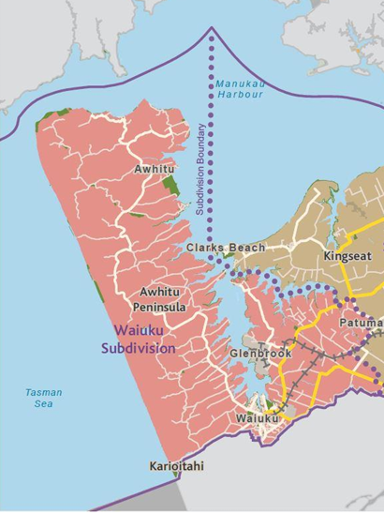
Local parks in Waiuku subdivision referred to by submitters
21 local parks:
Big Bay Reserve
Centennial Park
Colbeck Road Esplanade Reserve
Glenbrook Beach Esplanade Reserve
Glenbrook Foreshore Esplanade Reserve
Gordon Road Esplanade Reserve
Grahams Beach Esplanade Reserve
Hamilton's Gap
Hamilton Estate Reserve Park
Hudsons Beach Esplanade Reserve
Karioitahi Reserve
Kevan Lawrence Park
Lady Jane Franklin Botanic Reserve
Lake Whatihua Reserve
Massey Park
Orua Bay Reserves
Tamakae Reserve
Te Toro Recreation Reserve
Tiware Stream Reserve (Constable Road Reserve)
Wattle Bay Reserve
Waiuku Sports Park

Slide 11
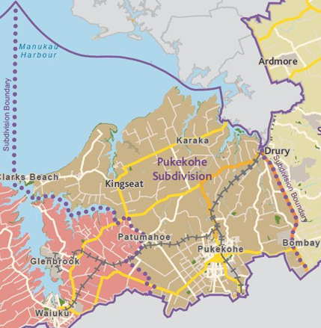
Local parks in Pukekohe subdivision referred to by submitters
46 local parks:
Anselmi Ridge Drainage Reserve
Auranga Dog Park
Avonbrook Lane Stormwater Reserve
Belmont Park
Bledisloe Park
Boyd Road Esplanade Reserve
Buckland Road Esplanade Reserve
Cape Hill Reserve
Cape Hill Subway Reserve
Clarks Beach Recreation Reserve
Clive Howe Road Recreation Reserve
Cloverlea Recreation Reserve
Colin Lawrie Fields
Edwards Court Reserve
Ernies Reserve/Brownlee Lake
Franklin Road Reserve
Glenbrook Beach Recreation Reserve
Helvetia Road Esplanade Reserve
Hickeys Recreation Reserve
Karaka Sports Park
Les Fisher Place Reserve
Martyn Farm Estate Esplanade Reserve
Max Short Drive Reserve
Kingseat Sports Park
O'Conner Drive Reserve
Paerata Dog Park
Paerata Reserve
Patumahoe Recreation Reserve
Premila Drive Reserve
Pukekohe Hill Reserve
Pukekohe Arts Centre
Pukekohe Town Hall
Puni Recreation Reserve
Ray Fausett Reserve
Reidy Place Recreation Reserve
Reynolds Road Reserve
Rooseville Park
Rosa Birch Park
Roulston Park and Pioneer Cottage
Saddleton Road Esplanade Reserve
Samuel Miller Park (Nelson Street Reserve)
Taihiki River Esplanade Reserves (Waiau Beach to Mauku Bridge)
Twomey Drive Reserve
Waiau Beach Boatramp Reserve
Waiau Beach Esplanade Reserve
Whitecliffs Drive Esplanade Reserve

Slide 12
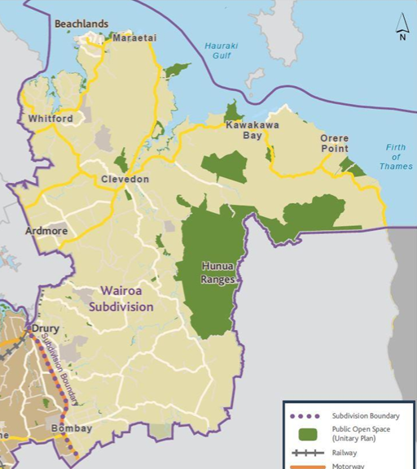
Local parks in Wairoa subdivision referred to by submitters
42 local parks:
600 Whitford Maraetai Esplanade Reserve
Ardmore Quarry Park
Angiangi Street Stormwater Reserve
Beachlands Domain
Bell Field/Ardmore Hall
Clevedon Kawakawa Road Esplanade Reserve (McNicol Road)
Clevedon Hall
Clevedon Scenic Reserve
Clevedon Showgrounds Reserve
Clevedon Wharf Reserve
Clevedon Village Reserve
Clifton Road Esplanade Reserve
Dr Adah Platts-Mills Reserve
Green Bay Reserve
Hunua Domain Recreation Reserve
Hunua Bowling Club and Field
Hunua Hall and Tennis Court
Hunua Road Esplanade Reserves
Hunua Village Green
Jack Lachlan Drive Esplanade Reserve
Kahawairahi Drive Reserve
Kawakawa Bay Foreshore Reserve
Kawakawa Coast Road Esplanade Reserve
Ken Parker Reserve (Bell Road Reserve)
Kennelly Park
Leigh Auton Reserve
Maraetai Foreshore Reserve
Maraetai Park
McRobbie Road Esplanade Reserve
North Road Esplanade Reserve
North Road Reserve
Omana Esplanade Reserve
Pine Harbour Park
Porterfield Road Esplanade Reserve
Possum Bourne Reserve
Potts Road Esplanade Reserve
Pratt Road Recreation Reserve/Maketu Pa Historic Reserve
Shelly Bay Reserve
Sunkist Bay Reserve
Te Pene Reserve/Tracey's Walk
Te Puru Park
Whitford Point Reserve

Slide 13






Submissions relating to Question 1
“Do you have any ideas or suggestions for the use, enjoyment, protection, management and development for local parks in your area?”
Key ideas and suggestions for Franklin’s local parks (190 comments from submitters)
 | Improving park connectivity (23%) – such as by developing better inter-park connections, linking esplanade reserves with new pathways/boardwalks |  | Better public safety in parks (11%) – such as better management/control over vehicles driving at Karioitahi Beach, path lighting, bollards and gates in car parks
 | Upgrading sports fields (22%) – such as the football fields at Beachlands Domain, and sports fields at Karaka Sports Park |  | Improving biodiversity in parks (10%) – such as more tree planting
 | Improving/creating new paths/tracks within parks (13%) – such as improving paths that are flooded regularly, concreted paths instead of dirt paths |  | Improving other park assets (8%) – such as the boat ramp at Te Toro Recreation Reserve, upgrades to playgrounds/park furniture
N.B. – total theme percentages exceed 100% given some submitter comments were spread over multiple themes

Slide 14





Submissions relating to Question 2
“Can you tell us what you like about the park(s) in your local board area?
Key reasons and benefits of visiting Franklin’s local parks (95 comments from submitters)
 | Exercising/being active (41%) – such as walking, running, with dogs, cycling |  | Other sports (17%) – such as rugby, football, baseball, hockey, bowling
 | Informal recreation/environmental values (35%) – such as relaxing/taking time out, views/landscapes, appreciating nature |  | Picnics/barbeques (11%)
 | Hangliding/paragliding (20%) – in particular at Karioitahi Reserve/Beach |  | Aquatic activities (7%) – such as swimming, fishing, surfing
N.B. – total theme percentages exceed 100% given some submitter comments were spread over multiple themes

Slide 15


Submissions relating to Question 3
“Can you tell us what you don't like about the park(s) in your local board area?
Key issues and problems about Franklin’s local parks (74 comments from submitters)
 | Vegetation matters (27%) – requests for weeding, tree trimming, not enough trees/poor quality, lawn mowing |  | Track/path issues (19%) – such as slip damage from storms needing to be repaired, slippery/dangerous tracks
 | Lack of park connectivity (23%) – such as not being able to access parks easily, encroachments from private landowners, impact of leases |  | Rubbish concerns (11%) – such as insufficient rubbish bins, poor maintenance/collection of rubbish bins
 | Dog concerns (19%) – off leash dogs, irresponsible dog owners, lack of dog friendly areas/dog parks |  | Park assets/general issues (5%) – such as poor levels of maintenance and quality of park assets, lack of picnic tables and benches, public toilet block concerns, general drainage issues
N.B. – total theme percentages exceed 100% given some submitter comments were spread over multiple themes

Slide 16
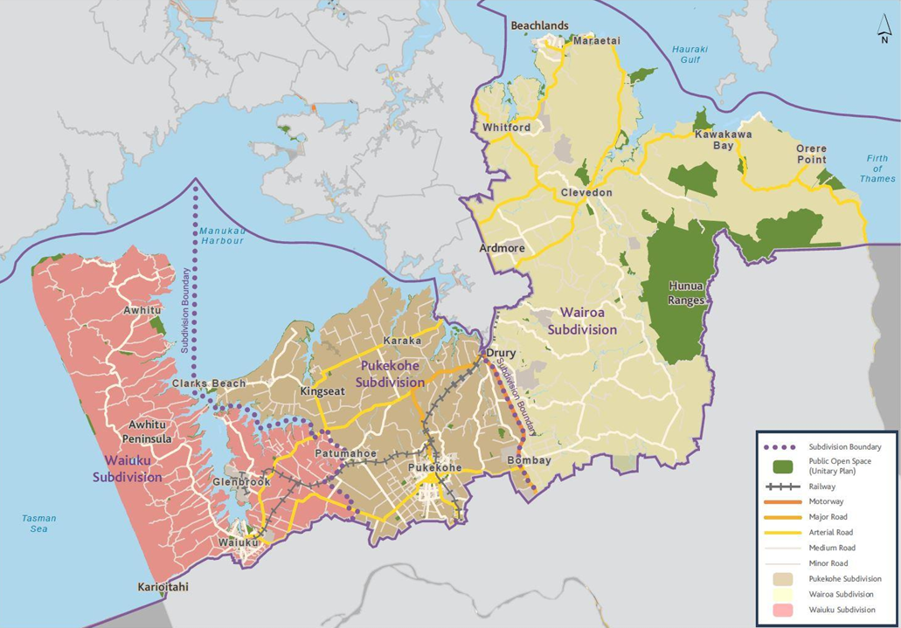
Franklin Local Board Subdivisions - Parks with the most submissions
Waiuku Subdivision:
  Karioitahi Recreation Reserve
  Te Toro Recreation Reserve
  Massey Park
Pukekohe Subdivision:
  Hickeys Recreation Reserve
  Karaka Sports Park
  Bledisloe Park
Wairoa Subdivision:
  Beachlands Domain
  Bell Field/Ardmore Hall
  Te Puru Park

Slide 17
Waiuku Subdivision

Slide 18
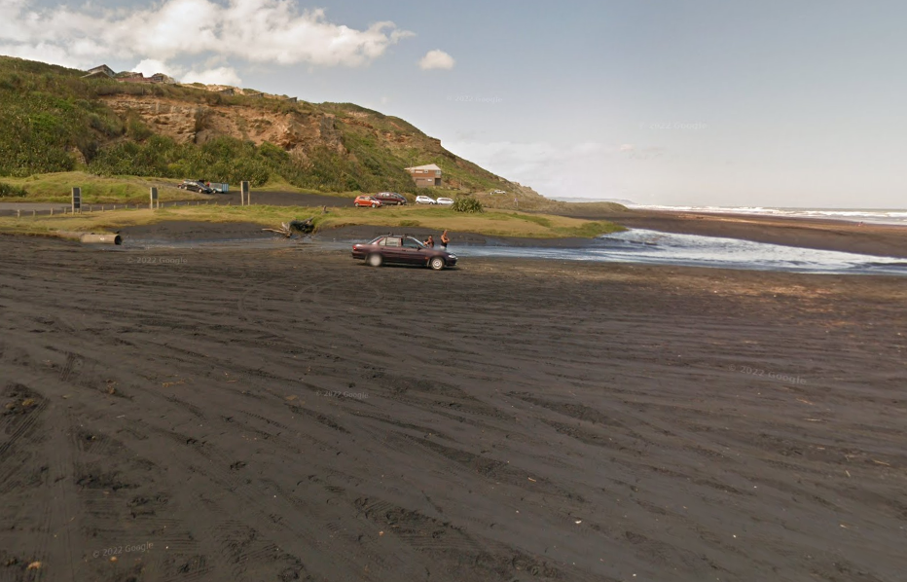
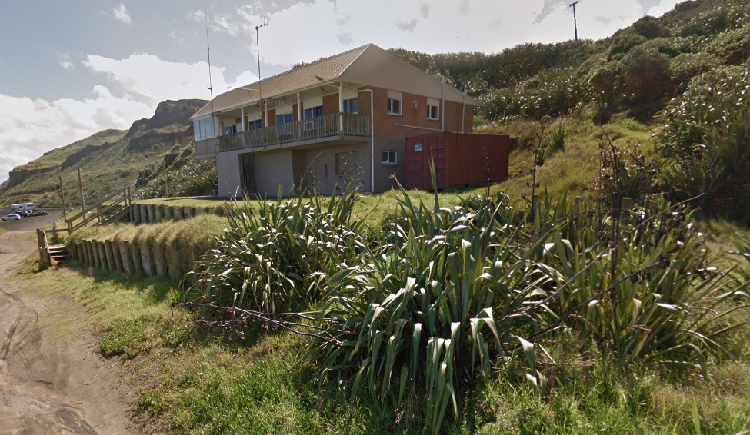
Karioitahi Reserve/Beach
41 submitters commented
Most common themes:
  Recreational use, such as paragliding/hang gliding/ informal activities (54%)
  Public safety/vehicle access (39%)
  Environmental concerns, such as damage to sand dunes and nesting areas for native birds (22%)

Slide 19
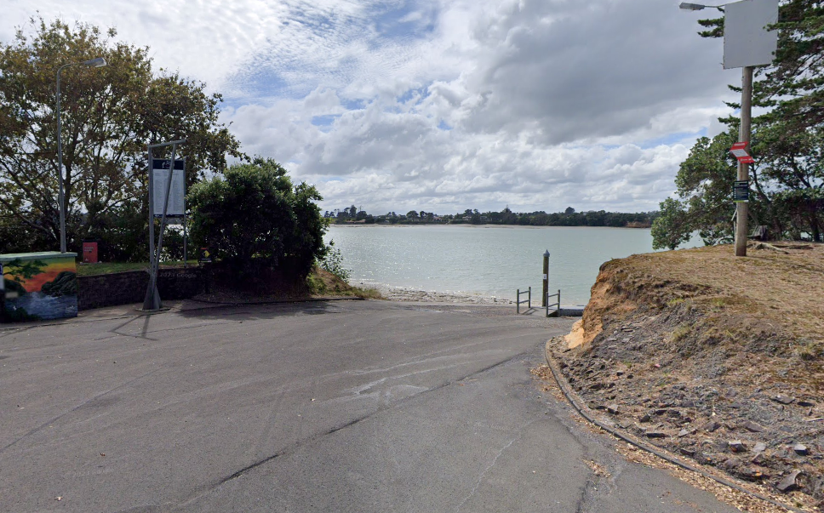
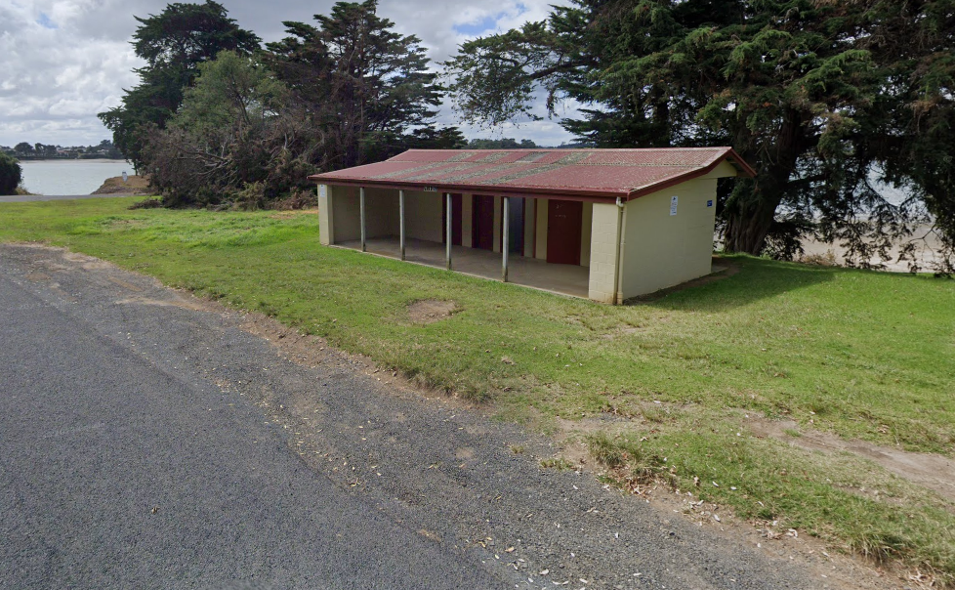
Te Toro Recreation Reserve
15 submitters commented
Most common themes:
  Issues with the boat ramp, in particular mud and regularity of potholes occurring – seeking more frequent maintenance.
  Request for replacement of the poles and pontoons, due to being in a poor condition.

Slide 20
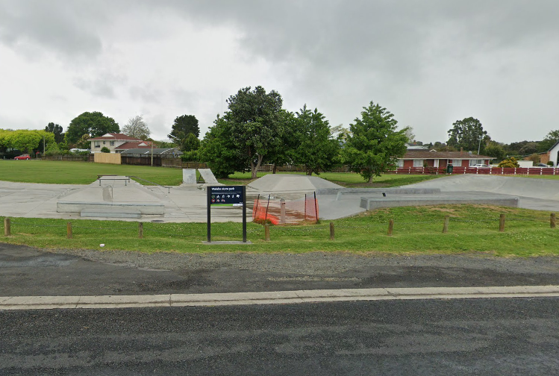
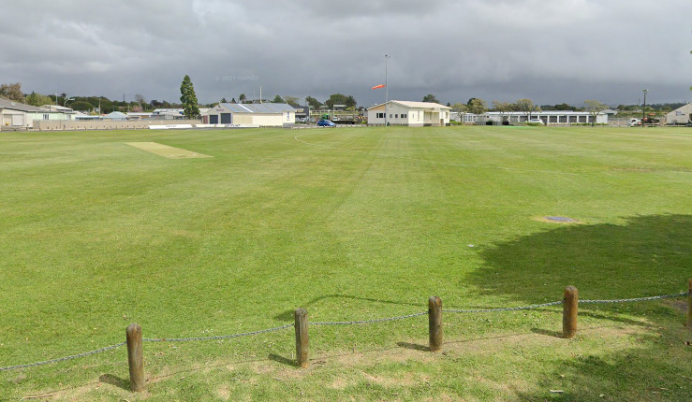
Massey Park
4 submitters commented
Most common themes:
  Concern about small vehicles and motorbikes going onto the park and damaging the fields, and wider anti-social behaviour observed
  Issue raised about state of park lighting
  Requested upgrade of playground/basketball court – due to conflict between users

Slide 21
Pukekohe Subdivision

Slide 22
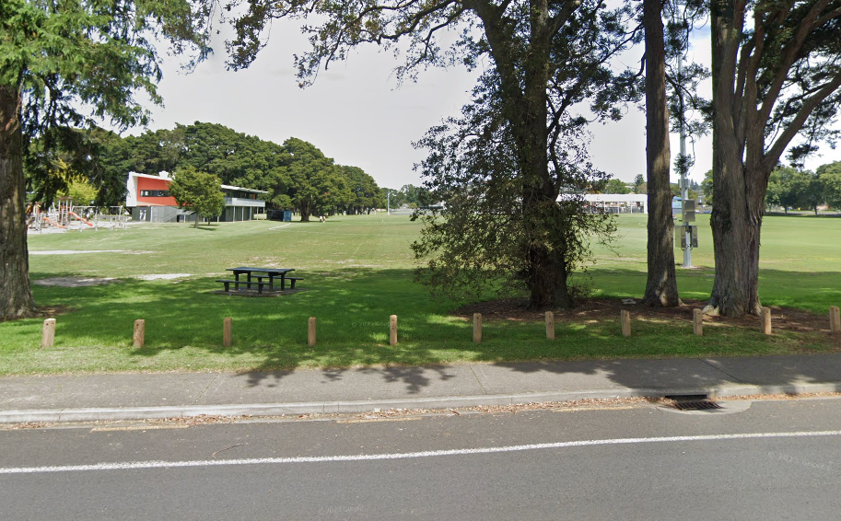
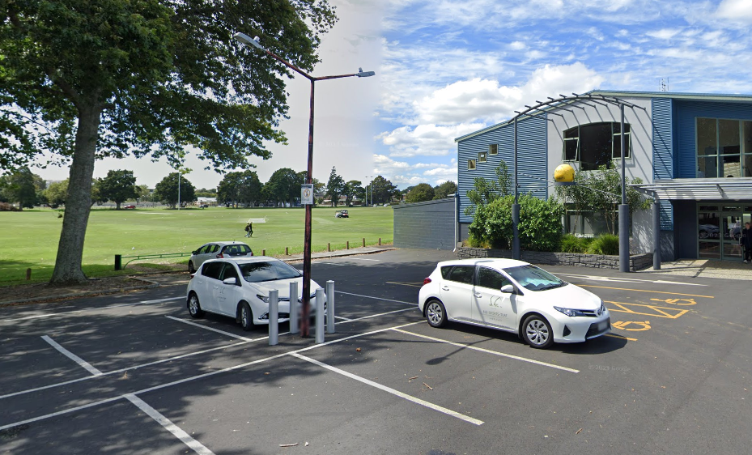
Hickeys Recreation Reserve
9 submitters commented
Most common themes:
  Creating more pathways between Hickeys Recreation Reserve and nearby parks, especially along the Whangapouri Creek.
  Need for more park maintenance, such as removing the weeds and rubbish dumped in and around the stream.

Slide 23
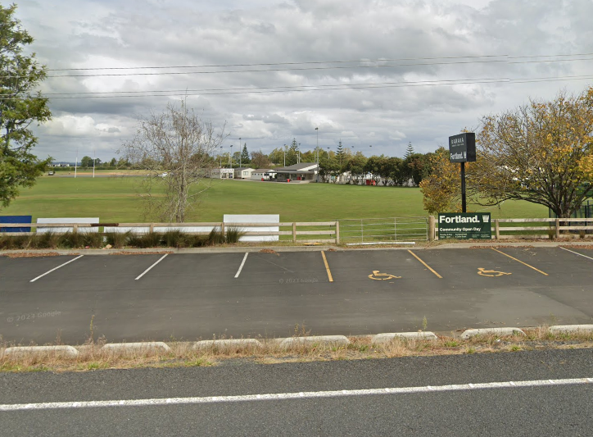
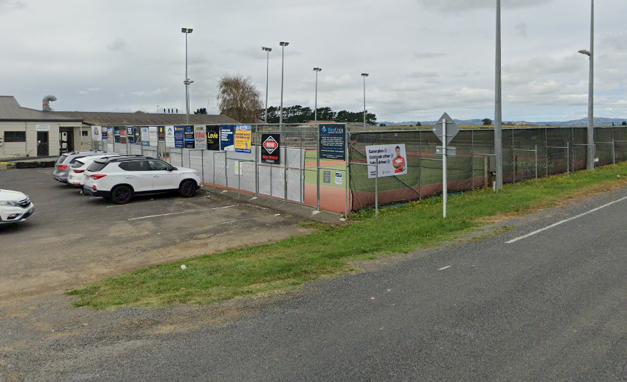
Karaka Sports Park
9 submitters commented
Most common themes:
  Upgrade the existing sport facilities and fields, such as resolving the drainage issues on the fields, improved/additional lighting.
  Concern around not enough playing fields given the high use of the park by many sporting codes such as baseball, rugby and cricket.
  Concern around funding constraints, slowing down the development of new sporting facilities at the park.

Slide 24
Bledisloe Park
7 submitters commented
Most common themes:
  Impact of car parking at peak times, can lead to grass areas being used as overflow car parks and damaging the fields as a result.
  Creating additional footpath connections within the park, such as from John Street to the netball courts.
  Developing a more integrated cycling/walking path network between Bledisloe Park and other parks in Pukekohe.

Slide 25
Wairoa Subdivision

Slide 26
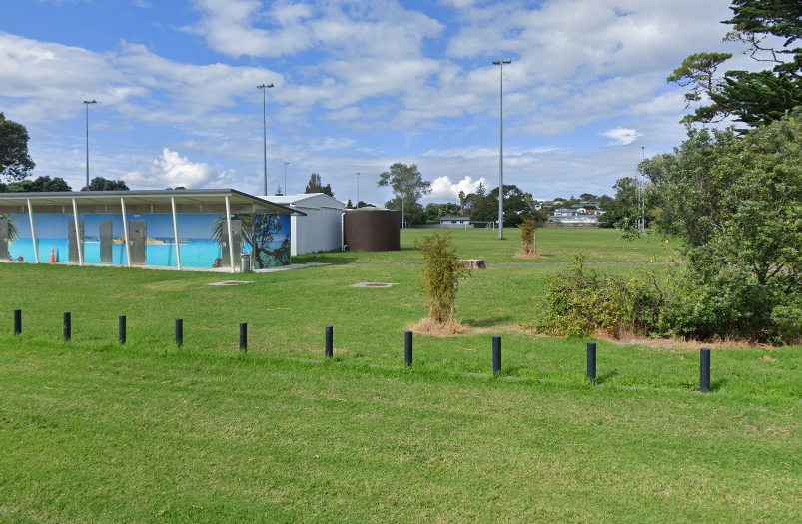
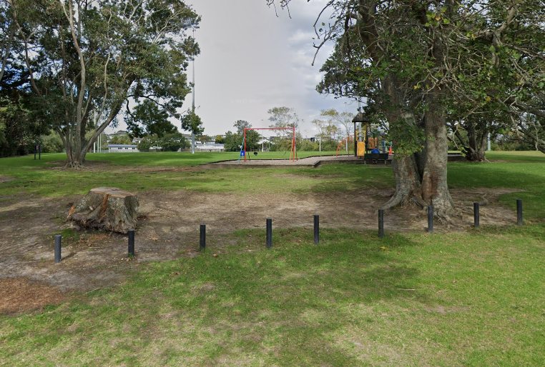
Beachlands Domain
27 submitters commented
Most common theme:
  All submitters requested the development of a new all-weather football pitch, due to the drainage issues regularly faced at this park.

Slide 27
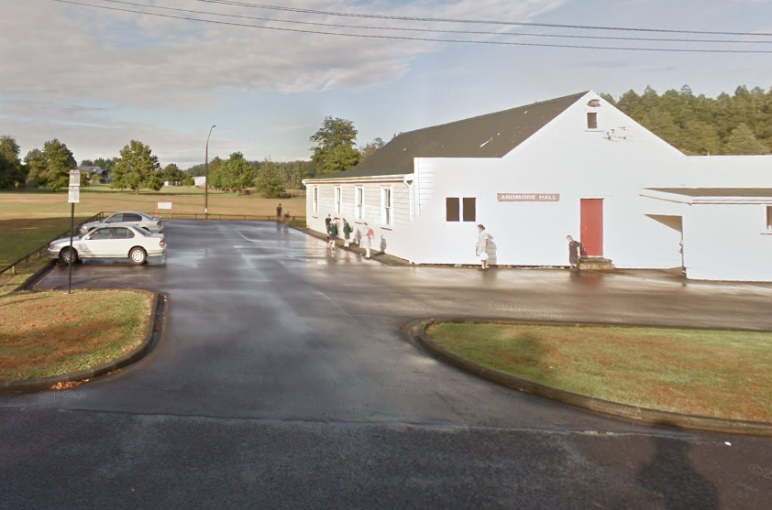
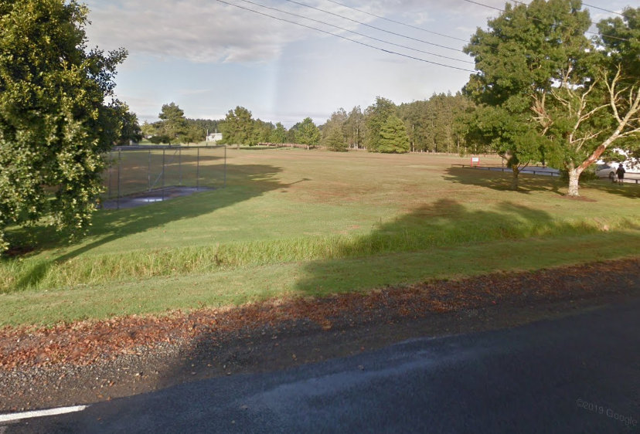
Bell Field/Ardmore Hall
19 submitters commented
Most common theme:
  All submitters requested a change of the land ownership and management from Auckland Council to another entity, due to concerns of vehicle/pedestrian safety.

Slide 28
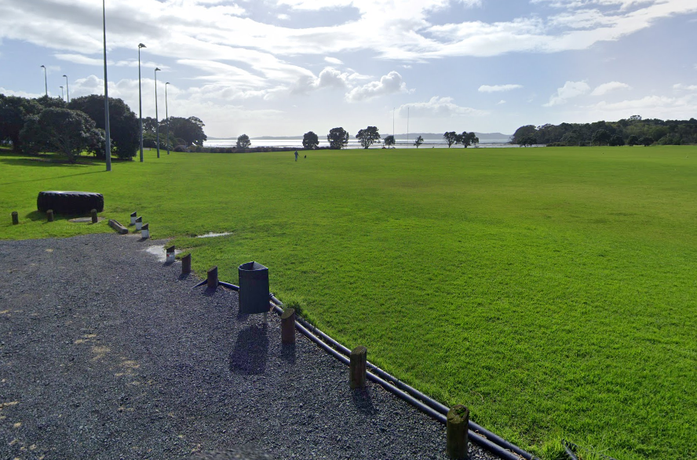
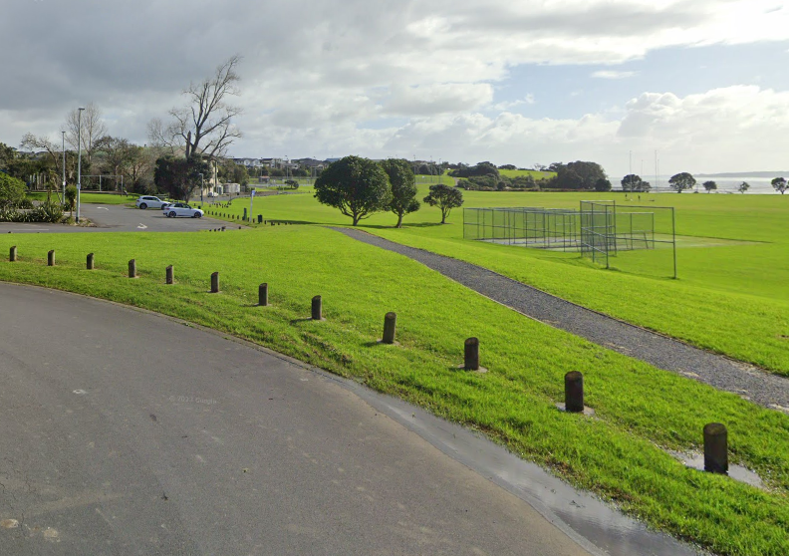
Te Puru Park
12 submitters commented
Most common themes:
  Improve the paths/tracks within the park, such as near the netball and basketball court, concreting existing paths, resolve drainage issues and move car park road away from fields.
  Upgrade/create new park assets, such as the skate park, more tennis courts and outdoor basketball courts.
  Create better walking and cycling connections to and from the park, such as to Maraetai.

Slide 29
Dr Adah Platts-Mills Reserve
11 submitters commented
Most common themes:
  Track repairs/maintenance, for instance flooding has caused slip damage and has washed out portions of the tracks
  Vegetation maintenance, such as more weed removal
  Stream issues, such as needing to remove rubbish and improve water quality
  Appreciation of the park’s mature native forest

Slide 30
Key Submitter Themes

Slide 31
Summary of main themes
  Esplanade Reserves
    A number of comments centred around access to/ from esplanade reserves across a number of local communities, such as:
      in Pukekohe with the reserves surrounding the Whangapouri Stream
      in Waiuku/Glenbrook surrounding the Manukau Harbour/Taihiki River
    Also it was noted that public access was restricted due to encroachments on public land such as with privately installed gates/fences.
  Karioitahi Reserve
    Some submitters noted their concern regarding access arrangements to/from the hang gliding/ paragliding launch site with the Castaways lessee.
Park connectivity

Slide 32


Summary of main themes
  Karioitahi Reserve
    A majority of comments on this theme are concerned with:
      vehicle use on the beach
      people worried about dangerous driving behaviours, vehicle and pedestrian incidents and near misses
      environmental damage to the surrounding area
  Other concerns
    A number of comments noted their concern with:
      Anti-social/intimidating behaviour, in parks and in car park areas
      Safety of school students at pick up/drop off points along a busy rural road, adjoining Bell Field/Ardmore Hall
      Lack of path lighting in some reserves for walkers, particularly women
Public safety/ vehicle use

Slide 33



Summary of main themes
Recreational/ sports activities
  Many submitters noted the value of Karioitahi Reserve, to provide for paragliding/hang gliding opportunities.
  Many submitters requested the development of new/improved sports facilities such as:
    New all-weather football pitch at Beachlands Domain.
    New sports facilities and improved maintenance of playing fields at Karaka Sports Park.

Slide 34
Summary of main themes
Dogs
  A number of submitters have noted their concern with dogs being off leash in parks and causing some level of distress/danger to other park users.
  Some submitters noted the presence of dog poo/a lack of dog waste bins in parks.
  Many submitters mentioned the benefits of local parks for exercising their dogs.

Slide 35
Summary of main themes
Vegetation and track maintenance
  A number of submitters made requests for either new tree plantings and/or more weeding to be done to better maintain their local parks, in particular at Platts Mills Reserve, Hickeys Recreation Reserve and Rooseville Park.
  Several submitters noted the need for track improvements/repairs, in particular at Platts Mills Reserve.

Slide 36

Summary of main themes
Coastal asset maintenance
  A number of submitters noted the need for more regular maintenance and replacement of failing assets at a number of launching sites for boats, in particular at Te Toro Recreation Reserve.
  Some submitters noted the seawall at Sunkist Bay Reserve in a state of disrepair and needing to be fixed.

Slide 37

Submissions from organisations/volunteer groups
Encourage further improvements to the connectivity for Franklin’s local park network, and have the LPMP seek to integrate the aspirations of a number of greenways/trails plans.
Opposes the potential of esplanade reserves to be considered for divestment across the Franklin Local Board area.
Ensure that reserves are able to provide for public access when leases, licenses and easements are granted.
Seek to mitigate the impact of encroachments on the community connectivity of local parks.
Herenga ā Nuku Aotearoa (Outdoor Access Commission)

Slide 38

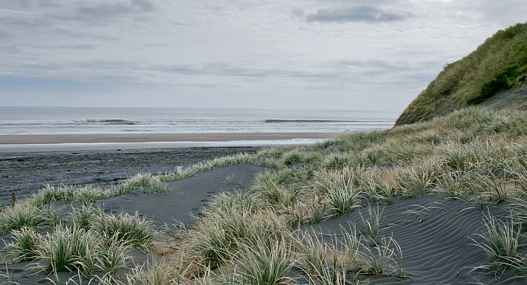
Submissions from organisations/volunteer groups
Redirect high-impact activities away from sensitive environments by developing bespoke recreational reserves.
Advocate to minimise vehicles on beaches and mitigate their impact (in particular Karioitahi Beach).
Provide for public green spaces with native plant canopy and pest control, providing habitat and food source for native wildlife.
Support local efforts to plant coastal dunes for erosion control.
Enact Te Tiriti o Waitangi, ensuring the voices of mana whenua are represented in both decision-making and the presentation of public spaces.
Āwhitu Peninsula Landcare

Slide 39

Submissions from organisations/volunteer groups
Whakaupoko Landcare
Provided an overview of volunteering work that has occurred in parks and reserves in Pukekohe, with the support of a number of schools (such as Tamaoho School, Waiua Pa School, Wesley College and Pukekohe High School).
Advocating for funding to further enhance the Pukekohe Five Summits Walk and Cycle Trail.

Slide 40

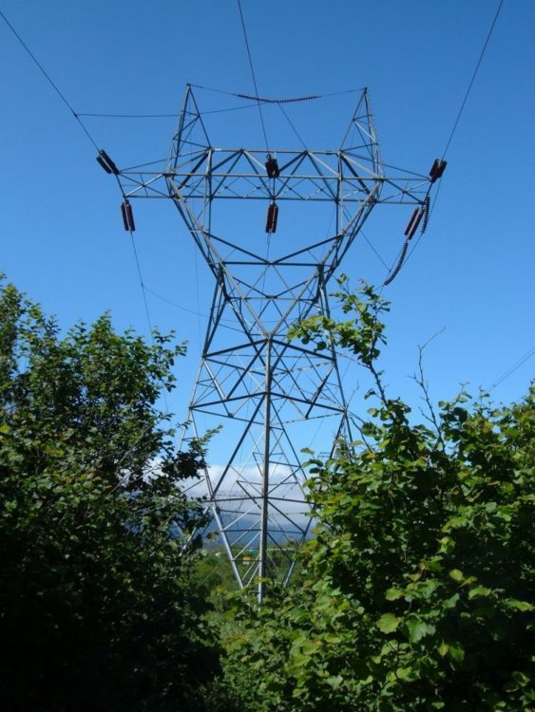
Submissions from organisations/volunteer groups
With the development of the Franklin Local Parks Management Plan, it is important to be aware of where transmissions lines intersect with the local parks network.
In particular, this is important to be aware of the implications of where trees can be planted in the park, and not being planted within close proximity of these transmission lines.
Transpower

Slide 41
End of presentation

